Slide 1
How Aging Services are Supported by
Programs and Divisions within DARS
V4A Presentation
September 25, 2020
Via Zoom

Slide 2
Presentation Outline
Federal Structure
DARS Structure and Role as SUA
Collaboration with other DARS Divisions
Division for Community Living and Office for Aging Services

Slide 3
Federal Structure

Slide 4
US Department of Health and Human Services
Tribal Grantees (282)
Administration for Community Living/Administration on Aging
State Units on Aging (56)
Area Agencies on Aging (618)
Local Service Provider Organizations
Consumers

Slide 5
Administration for
Community Living (ACL)
The Secretary of the Department of Health and Human Services established ACL on April 18, 2012.
This decision brought together the AoA, the Office on Disability, and the Administration on Developmental Disabilities.
ACL is the federal agency responsible for oversight of aging services and disability services.

Slide 6
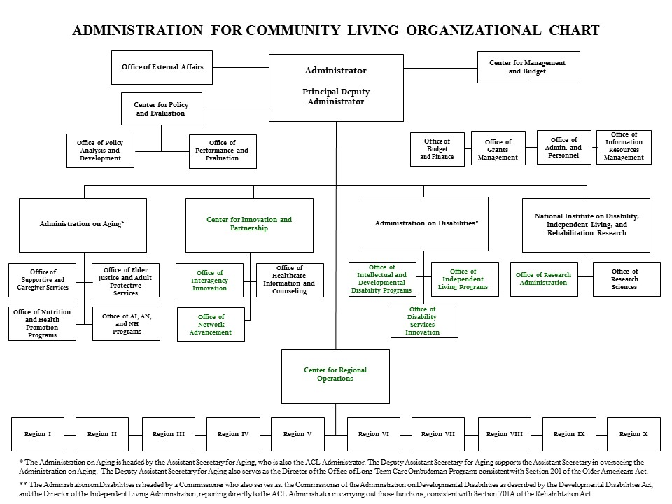

Slide 7
DARS Structure & Role as SUA

Slide 8
State Units on Aging (SUA)
SUAs are designated under 42 U.S.C § 3025(a)(1)
  This law requires states to designate an agency to:
    Develop and administer a state plan on aging;
    Be primarily responsible for planning, policy development, administration, etc. of state activities as it pertains to aging;
    Serve as an advocate for older individuals and provide technical assistance to any agency, organization, etc. representing the needs of older individuals; and
    Divide the State into distinct planning and service areas (PSAs).
In the Commonwealth of Virginia, DARS serves as the SUA
  DARS is designated as the agency to oversee all state programs using funds provided by the federal OAA and the Virginia General Assembly.

Slide 9
Additional SUA Roles
Designates AAAs w/ the assistance of local governments
Establishes Funding Formula and Disburses Federal and State Funds
Prepares and oversees Virginia’s State Plan for Aging Services
Approves AAA Area Plans and Develops Contracts with AAAs to Provide Services
Establishes Regulations, Service Standards, Policies, Guidelines
Monitors Programs and Fiscal Operations
Provides Technical Assistance and Training
Collects Data for Federal and State Reports
Notes:
In VA DARS is the SUA and most, but not all, of the SUA roles are implemented through the Office for Aging Services under the Division for Community Living.

Slide 10
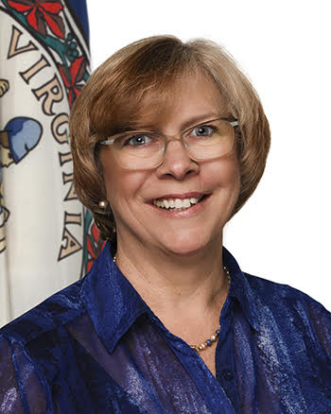
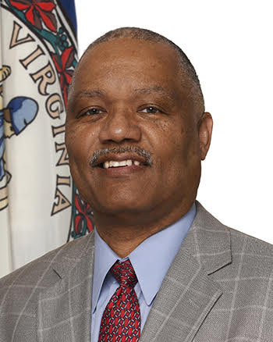
DARS Organizational Chart
Commissioner
Kathryn A. Hayfield
Assistant to the
Commissioner
Vacant
Chief Deputy
Commissioner
Scott Grimes
Fiscal and General Services
Chief Financial Officer
John Thaniel
Commissioner
Kathryn A. Hayfield
Division of
Human Resources
Div of Rehabilitative Services Deputy Commissioner
Dale Batten
Division for Community Living
Deputy Commissioner
Marcia DuBois
Information Services
Chief Information Officer
Lee Tinsley
Disability Determination
Services Deputy Commissioner
Leon Scales
Adult Protective
Services Director
Paige McCleary
Communications Manager
Betsy McElfresh
State Long-Term Care Ombudsman
Joani Latimer
Policy and Legislative
Affairs Director
Catherine Harrison
Information Security
Officer
Chandos Carrow
Internal Audit Director
Vacant

Slide 11
Division for Community Living &
Office for Aging Services

Slide 12
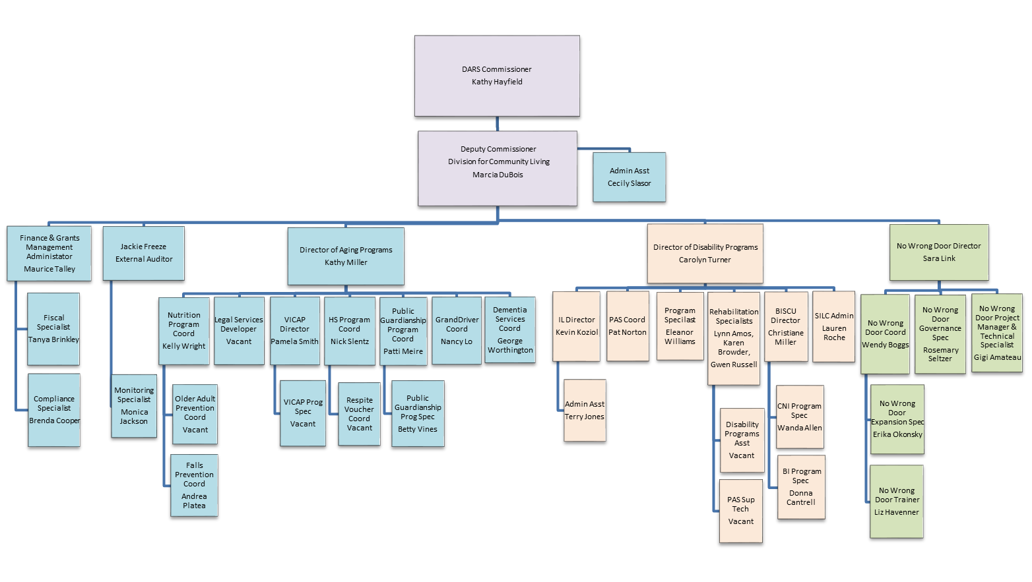
Division for Community Living

Slide 13
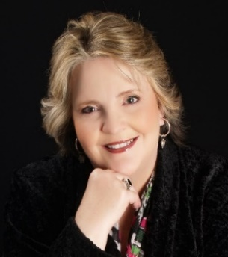
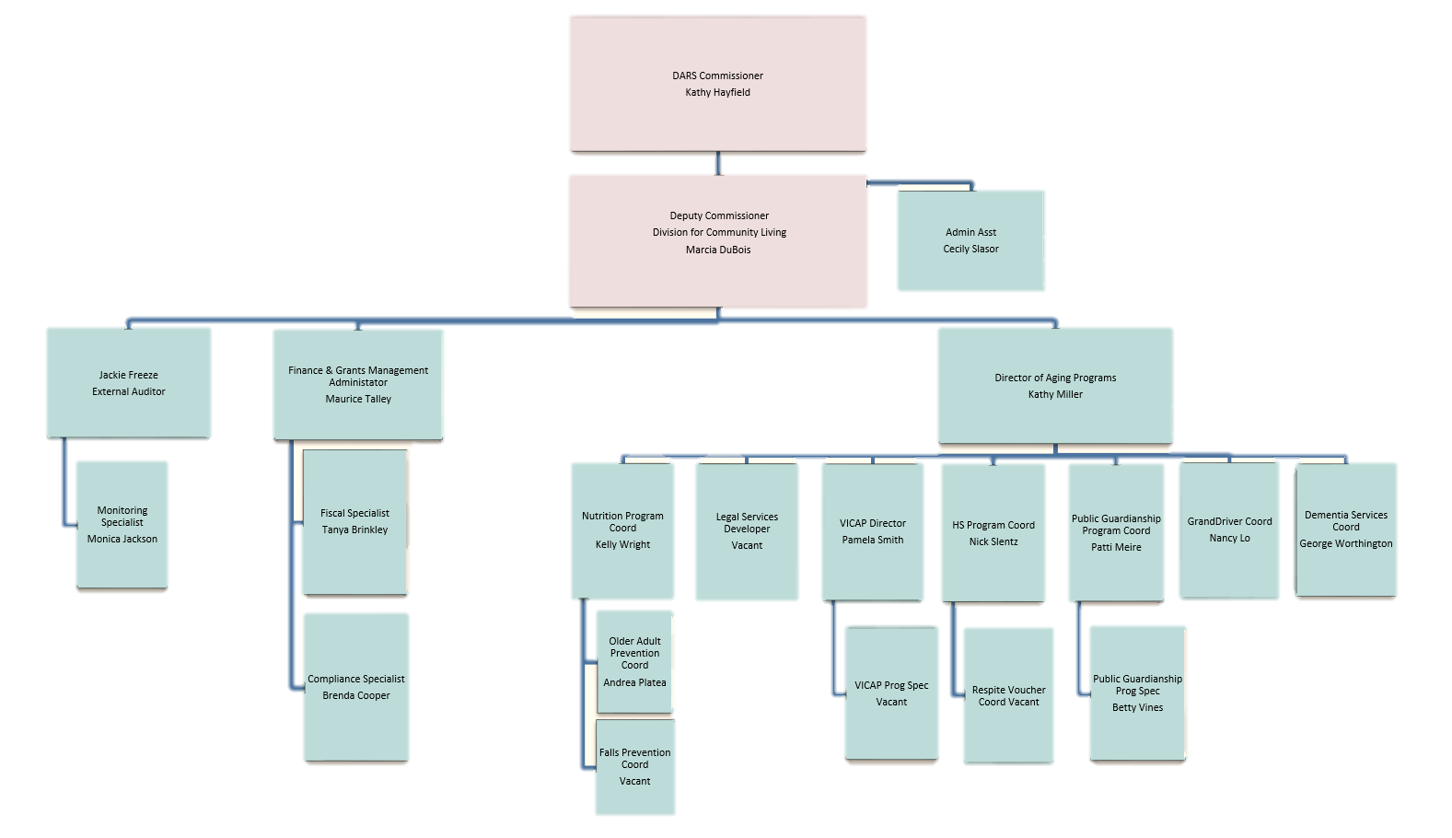
Office for Aging Services
Kathy Miller, Director

Slide 14
OAA Core Services and Programs
Care Coordination
Care Transitions
Communication Referral Information Assistance
Options Counseling
Transportation
Assisted Transportation
Adult Day Care
Homemaker
Personal Care
Legal Assistance
Employment
Nutrition Services
Disease Prevention and Health Promotion
NFCSP
Elder Rights/Elder Abuse Prevention

Slide 15
Other OAS Programs and Services
Care Coordination for Elderly Virginians Program
CDSME Program
Falls Prevention Program
Public Guardianship and Conservator Program
GrandDriver
Dementia Services
Virginia Lifespan Respite Program
Senior Farmers’ Market
Senior Cool Care
VICAP

Slide 16
Monitoring, Oversight, and Technical Assistance
DARS is responsible for oversight of the local AAAs and contractors
This is done through three functional areas
AAA and Other Contractor Administration
Program Operations
Governance and Fiscal Operations
There are two types of monitoring
Desk Reviews
On-site reviews
Ongoing oversight of AAA’s is done more frequently via monthly statistical and financial reports
On-Site reviews are done with the requirement of all 25 AAAs being reviewed within a 3-year period
Enhanced Desk Reviews have occurred during scheduling changes or emergencies, such as COVID-19

Slide 17



State Plan on Aging
Required by the OAA and Code of Virginia
Establishes goals related to aging services across the state.
The State Plan on Aging Includes
Virginia aging demographics
Areas of Focus for Aging Services
Plans for quality management of services
Information on funding

Slide 18
Virginia Advisory Committees
Commonwealth Council on Aging
Alzheimer’s Disease and Related Disorders Commission
Virginia Public Guardianship and Conservator Advisory Board
Virginia Caregiver Coalition
While each Advisory Committee is maintained by the division in which it is housed, it is also guided by the Policy and Legislative Affairs Division.
Each committee and coalition serves in an advisory capacity for the agency and legislators on policy, education, and resources.

Slide 19
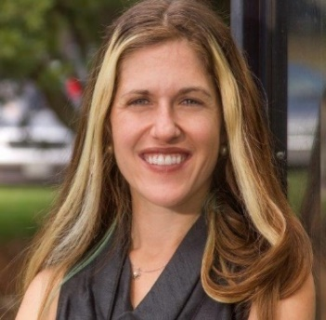
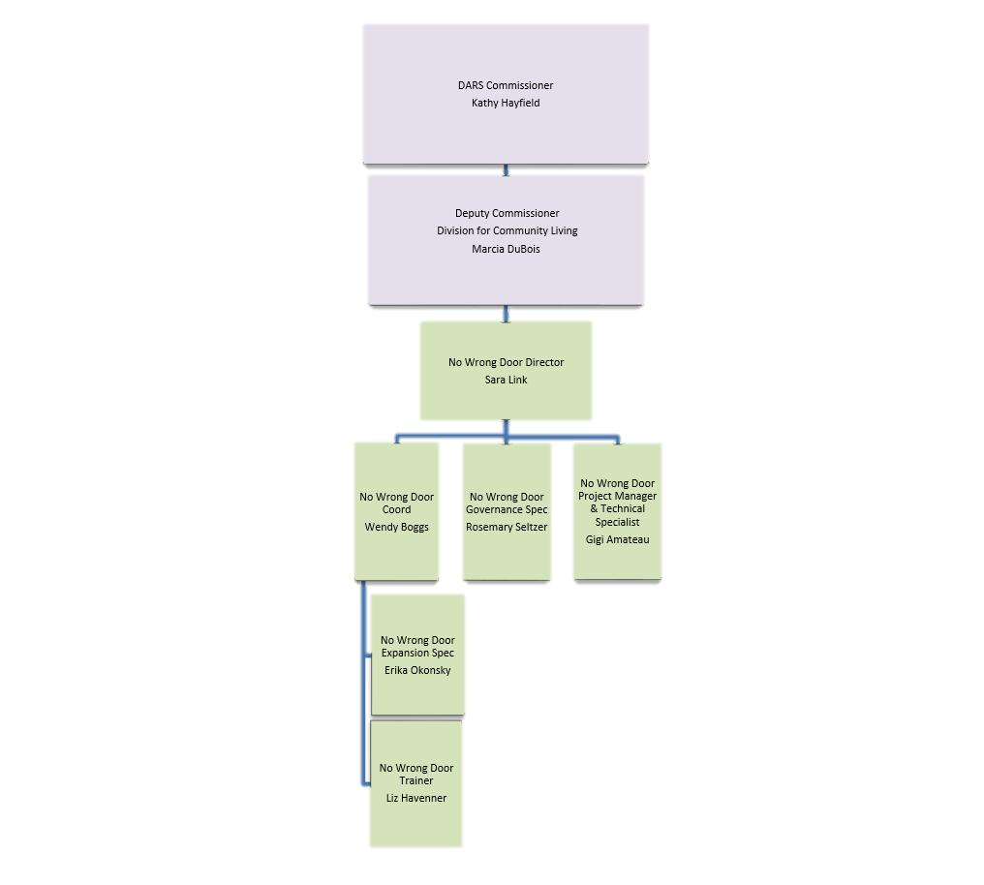
No Wrong Door
Sara Link, Director

Slide 20
No Wrong Door
NWD and Aging services are interwoven programmatically and in the technology that is utilized by both programs.
AAAs serve as the local leaders for NWD and NWD’s referral entry (CRIA) is the portal for the entire referral and case management data system utilized by OAS, NWD, LTRCM, APS/AS, VATS and many other certified NWD partners.
NWD team has worked across DCL and with OAS staff on numerous grants including Options Counseling and CMS/LTSS.
Virginia’s NWD initiative is recognized nationally for its innovation in governance, person centered options counseling training and technology.

Slide 21
Aging and Disability Intersection
No Wrong Door Initiative / ADRC
Virginia Navigator
&
2-1-1 Virginia
Started in 2003 throughout the United States.
Still ongoing and recognized important intersection of aging and disability services and supports.
Partnership with Virginia Navigator & 2-1-1.
VN is Senior Navigator, Disability Navigator, Veterans Navigator connecting services for aging and disabilities.

Slide 22
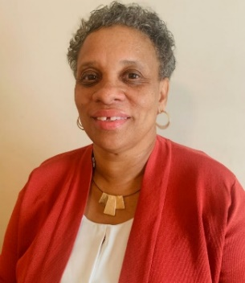
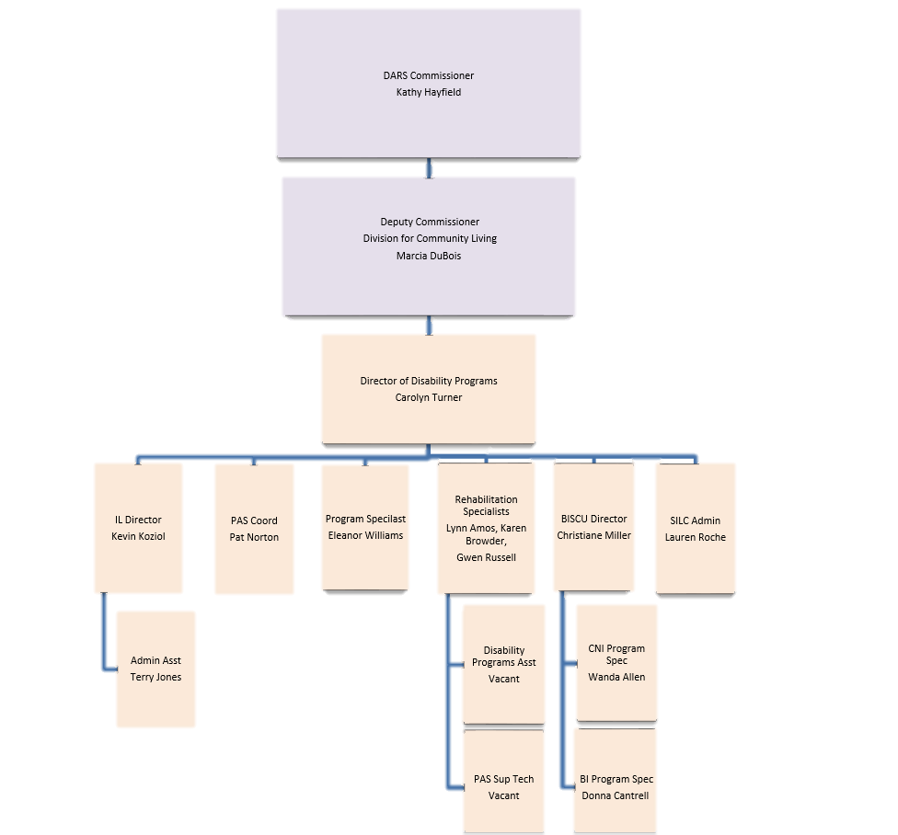
Office of Disability Programs
Carolyn Turner

Slide 23
Office for Disability Programs
Centers for Independent Living (CILs) and NWD
  CILs have collaborated with OAS on CDSME grants and Falls prevention grants as well as activities with AAAs at the local level.
  CILs have also offered options counseling in partnership with OAS and NWD for many years and recently expanded their partnership with NWD.
  The DARS NWD and CIL teams have worked together on a number of training projects including NCAPPS.
Brain Injury (BI) Services and Falls Prevention
  TBI screenings are allowed under Title III in the new OAA reauthorization.
  The Brain Injury Unit is also beginning to work with NWD under a new grant and was also involved with the NCAPPS grant.
Brain Injury (BI) Services and Dementia Services
  There are links between BI and incidence of dementia in later life.
  This makes partnerships between disability programs and aging programs on grants such as Falls Prevention, Dementia Services, Traumatic Brain Injury, and CDSME so important.
Intellectual Disability and Dementia
  There are links between Intellectual Disability and dementia in later life.
  This makes partnerships between disability programs and aging programs on Dementia Services and CDSME important.

Slide 24
Collaboration with other
DARS Divisions

Slide 25
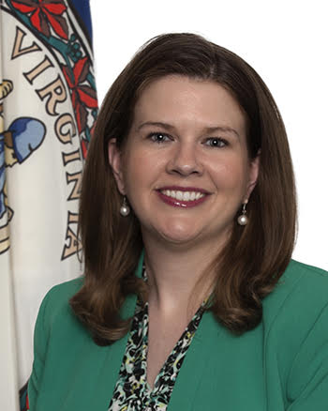
Policy and Legislative Affairs
Catherine Harrison, Director
Charlotte Arbogast, Policy Analyst
Barbara Burkett, Lead Analyst, Research & Evaluation
Matt Doum , Research and Evaluation Assistant
Mable Fleming, Senior Analyst, Research and Evaluation
Leah Mills, Policy Analyst
Elizabeth Patacca, Administrative Staff Assistant

Slide 26
Collaborations with
Policy & Legislative Affairs
Policy and Regulatory Guidance for OAS is provided through DARS Policy & Legislative Affairs Division, which is extremely knowledgeable about aging-related legislation.
Policy & Legislative Affairs Division in DARS provides support to OAS in developing the Virginia Plan for Aging Services required under 42 U.S.C § 3025(a)(1).
Policy & Legislative Affairs Division provides staff support to the Commonwealth Council on Aging.
Legislative updates and guidance for Aging Services and topics

Slide 27
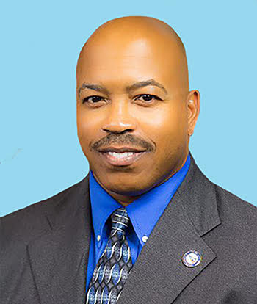
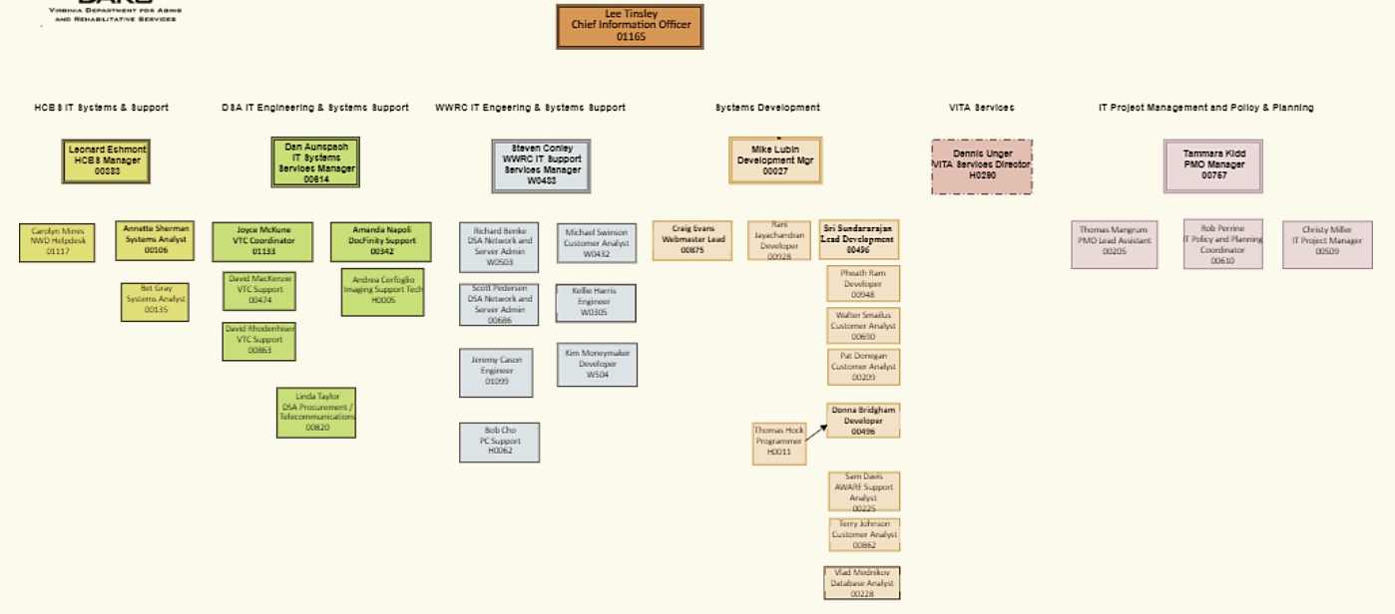
Information Technology
Lee Tinsley, CIO

Slide 28
Collaborations with IT
Coordinates with all programs using PeerPlace technology (ITPAC)
Supports initiatives
Troubleshoots issues and barriers
Explores new enhancements /initiatives to benefit Aging Services
Coordinates with Information Security Officer (Chandos Carrow) to ensure compliance with requirements

Slide 29
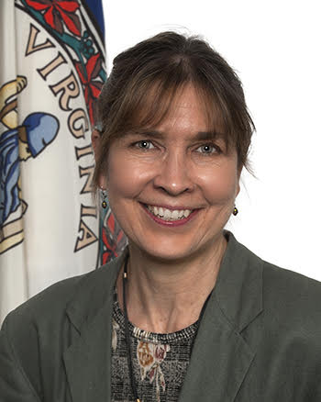
Long Term Care Ombudsman
Joani Latimer, Director
Gail Thompson MA, MSW, Asst. State LTC Ombudsman
Kimberly Pugh, Program Admin Assistant
Linda Hamrick, Coordinated Care Advocate Manager
Leticia Rasnick, Managed Care Advocate
Karin Roth, Coordinated Care Advocate

Slide 30
Collaboration with OSLTCO
OAS provides financial support services to OSLTCO
Governor’s COVID-19 Long-Term Care Facility Task Force
DMAS Caregiver workgroup
General AAA and ACL communications
VICAP

Slide 31
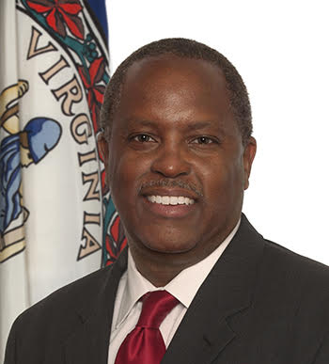
Fiscal & General Services
John Thaniel, CFO
General Services
Manager: Greg Dunaway, General Services Director (PPE, VEST, VDEM)
Jason Illig, Logistics Manager
Beth Prunkl, Procurement Manager (AAA contracts and procurement)
Chip Stratton, Safety Officer, Emergency Management Coordinator (PPE, VEST, VDEM, AFNAC)
Grants & Contracts
Manager: Sharon Collins - Reporting and Accounting Manager
Teresa Bennett, Grants and Cash Management Analyst (GrandDriver, Falls Prev.)
Mary Castlebury, Senior Grant Accountant (remittance, AMRs)
Marquita Crowder, Grants Financial Reporting Specialist (federal grants reporting)

Slide 32
Collaborations with Fiscal
Process payments to AAAs
Track AAA grant payments and remittance
Submit federal financial reports to ACL
Finalize contracts through procurement
Coordinate with the OAS fiscal team
Report the needs of AAAs to VDEM through VEST and AFNAC

Slide 33
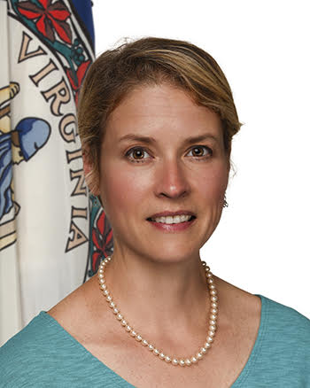
Adult Protective Services
Paige McCleary, Director
Venus Bryant, Admin Specialist
Barb Pratt, Adult Protective Services Curriculum Developer
Tishaun Harris Ugworji, AG Program Manager
Shelley Henley, Auxiliary Grant Program Consultant
Nicole Doyle, Program Consultant Senior
Andrea Jones, Program Specialist
Carol McCray, Program Specialist
Angie Mountcastle, Program Specialist
Carey Raleigh, Program Specialist

Slide 34
Collaborations with APS
Elder Abuse Prevention (VCPEA)
Legal Services Program
Public Guardianship Program
ITPAC

Slide 35
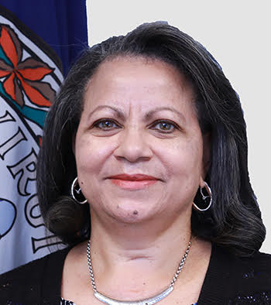
Division of Rehabilitative
Services (DRS)
Dale Batten, Deputy Commissioner
Vocational Rehabilitation
Wilson Workforce Rehabilitation Center (WWRC)
Virginia Assistive Technology System (VATS)
Workforce Programs
Grants & Project Implementation

Slide 36
Collaborations with DRS
NWD/VATS
Senior Community Service Employment Program (SCSEP)
New SCSEP Senior Tech Career Support Grant

Slide 37
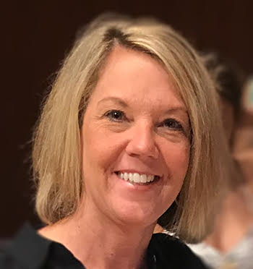
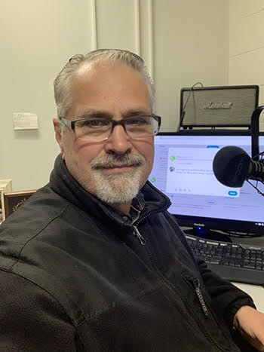
Communications
Betsy McElfresh and Rick Sizemore
Social Media
Newspaper articles
Videos
Push out local stories
Share AAA stories
Prepare materials for HHR/Governor
Prepare materials for VICAP, Senior Farmers Market, & GrandDriver

Slide 38









Fiscal
Process payments to AAAs
Track AAA payments and remittance
Submit federal reports to ACL
Contracts and procurement
Coordinate with the OAS fiscal team
Coordinate w/ VDEM, VEST & AFNAC
Division for
Rehabilitative Services
NWD/VATS
Senior Community Service Employment Program (SCSEP)
New SCSEP Senior Tech Career Support Grant
Communications
Social Media
Newspaper articles
Videos
Share AAA stories
Adult Protective Services
Elder Abuse Prevention (VCPEA)
Legal Services Program
Public Guardianship Program
ITPAC
No Wrong Door
  NWD and OAS are interwoven programmatically and technologically
  AAAs serve as the local leaders for NWD and NWD’s referral entry (CRIA) is the portal for the entire referral and case management data system utilized by OAS, NWD, LTRCM, APS/AS, VATS and many other partners.
  NWD team has worked across DCL and OAS staff on numerous grants including Options Counseling, and CMS/LTSS
Disability Programs
CILS/Brain Injury
LTC Ombudsman
OAS provides financial support services to OSLTCO
Governor’s COVID-19 LT Care Facility Taskforce
DMAS Caregiver workgroup
General AAA and ACL communications
  Options Counseling with OAS and NWD
  CDSME grants
  TBI screenings are under OAA Title III
  Training projects with NWD
  Falls Prevention grants
  NWD and NCAPPS grant
Information Technology
Coordinates w/ all programs using PP
Supports initiatives
Troubleshoots issues
Explores new enhancements
  Policy and Legislative Affairs
  Provides Policy & Regulatory Guidance
  Provides support to OAS in developing the Virginia Plan for Aging Services
  Provides staff support to the CCoA
  Legislative updates and guidance for Aging Services and topics
Notes:
It takes a village to support OAS and the duties and initiatives of the SUA!

